Slide 1
Employ Attrition Analysis HR Dashboard

Slide 2
Introduction
In the dynamic landscape of modern businesses, employee attrition poses a significant challenge for organizations striving to maintain stability and growth. XYZ Company, established a few years ago, has been grappling with a persistent attrition rate of approximately 15% over the past couple of years. This trend not only disrupts operational continuity but also impacts the company across various facets, including productivity, morale, and overall organizational effectiveness.
Recognizing the critical need to address this issue, XYZ Company has engaged the services of an HR analytics consultancy. As a pivotal member of this initiative, I assume the role of the HR analyst tasked with delving into the data to uncover the root causes of employee turnover and devise strategies to mitigate it effectively. Through the implementation of a comprehensive analytics approach, the aim is to provide XYZ Company with actionable insights, enabling informed, data-driven decisions in their quest to reduce attrition rates and foster a more stable and engaged workforce.
This introduction sets the stage for a focused analysis aimed at understanding the complexities surrounding employee attrition within XYZ Company. By harnessing the power of data analytics, we endeavor to unearth underlying patterns and factors contributing to attrition, paving the way for strategic interventions tailored to address the organization's specific challenges and aspirations.

Slide 3
Quick Insight
4410
Overall Employee
711
Attrition
16.12%
Attrition Rate
4410
Active Employee

Slide 4
Main KPIs
Overall Attrition – Total employee Attrition
Average Age – Average age of employee during attrition
Department Wise Attrition And Count of Over 18 by age & Gender
Job Satisfaction Rating – Employee satisfy with job rating
Education Wise Attrition – Education level wise attrition
Attrition Rate by Age Group

Slide 5
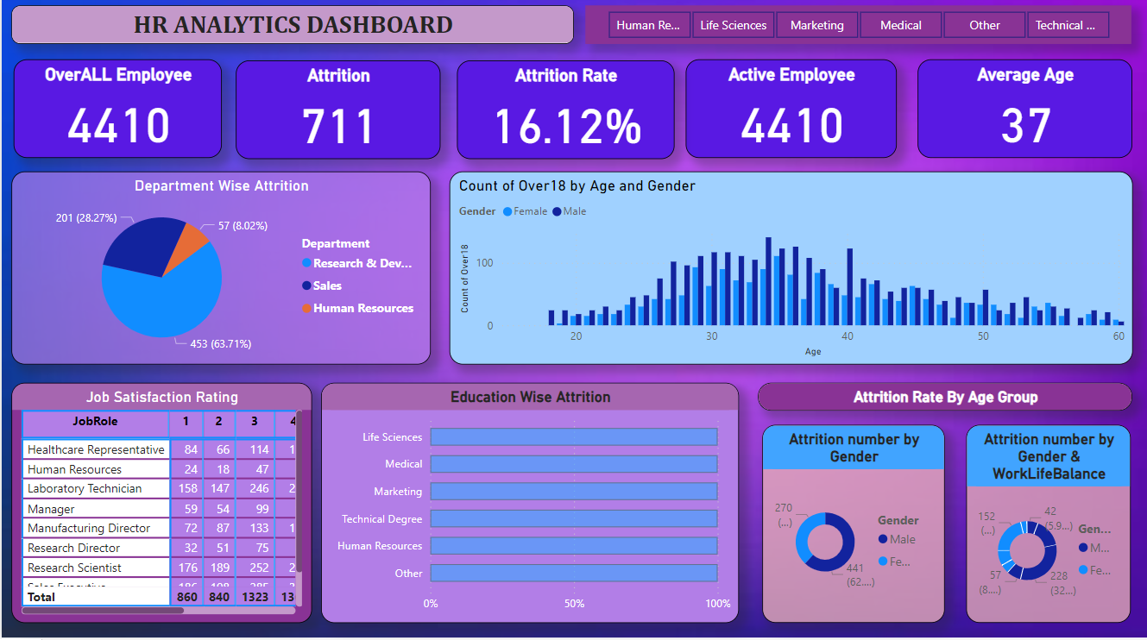
Dashboard

Slide 6
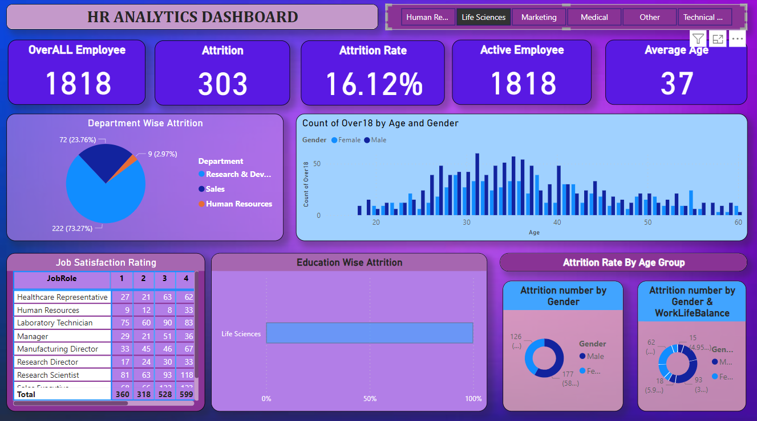
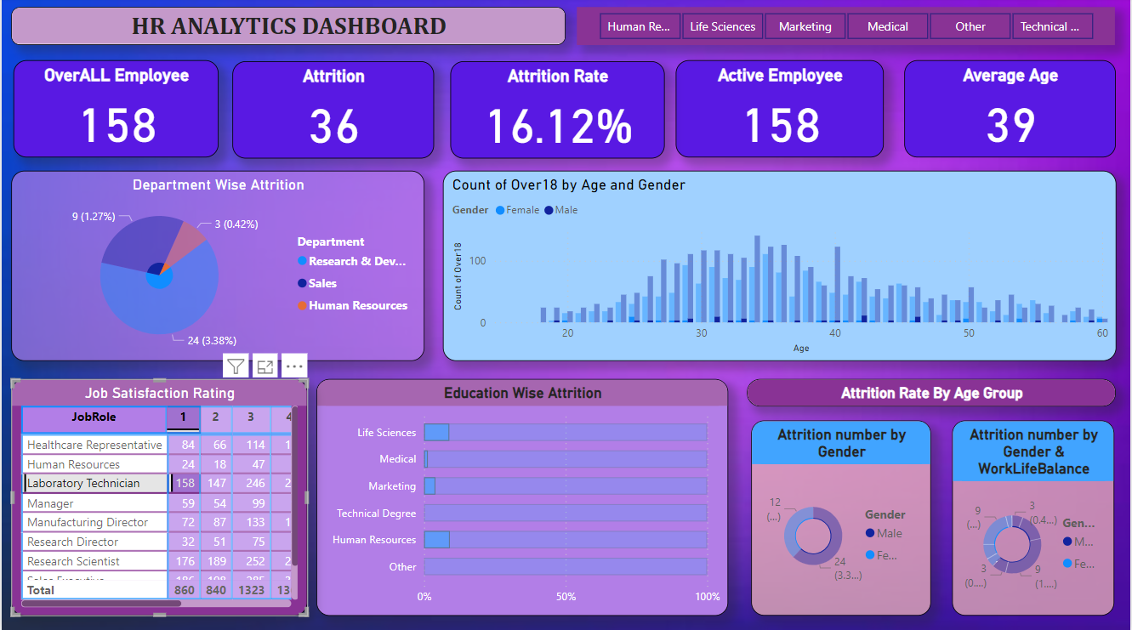
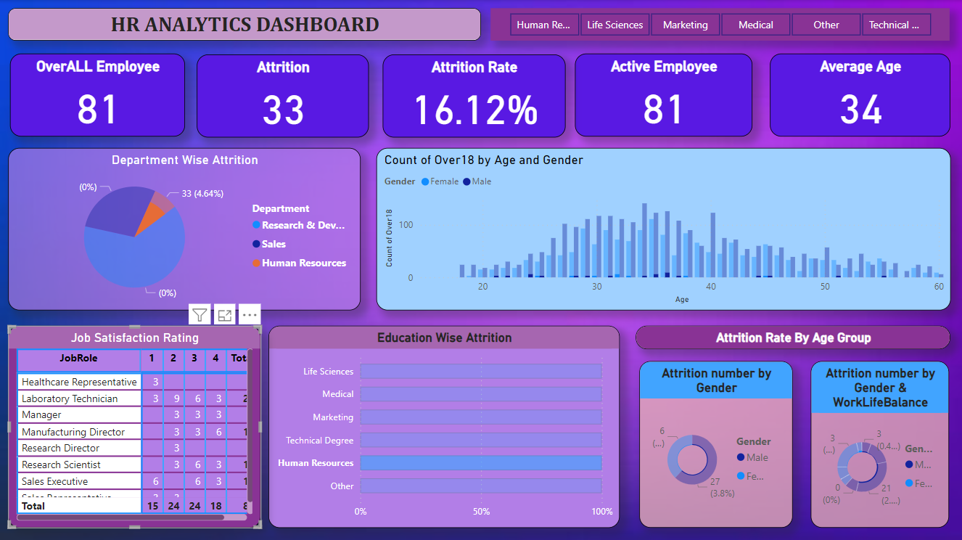
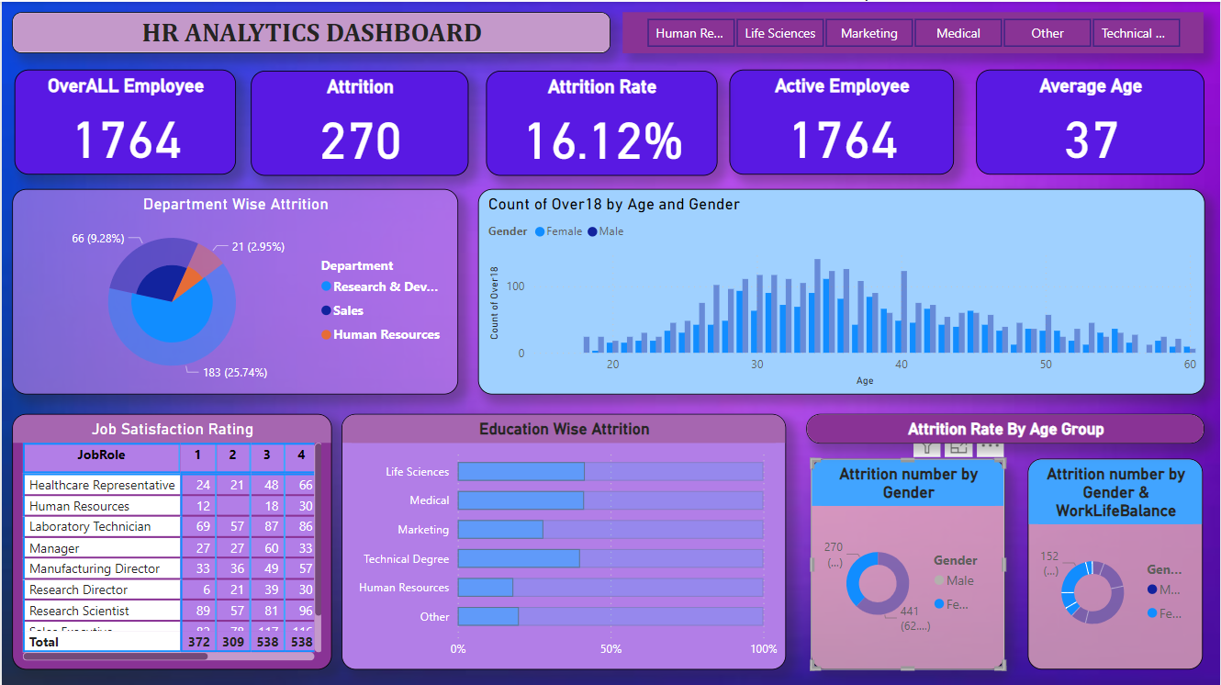
Working Dashboard

Slide 7
Thank you

